Slide 1


YAPG - Yet Another Pong Game
CSE – 316 Term Project

Slide 2


YAPG
Submitted By:
Shehabul Islam Sawraz (1805088)
Mohammad Abrar Nafee Akhand (1805089)
Mobaswirul Islam (1805090)
Supervised by:
Dr. Md. Monirul Islam
Dr. A. B. M. Alim Al Islam
Md. Masum Mushfiq

Slide 3
YAPG
Pong is a simple ”tennis-like” game that features two paddles and a ball. When one of the players misses hitting the ball with his paddle, the other gets a point.
For our first hardware project, we wanted to honor this very first computer game by recreating it with Microcontroller(ATMega32)

Slide 4
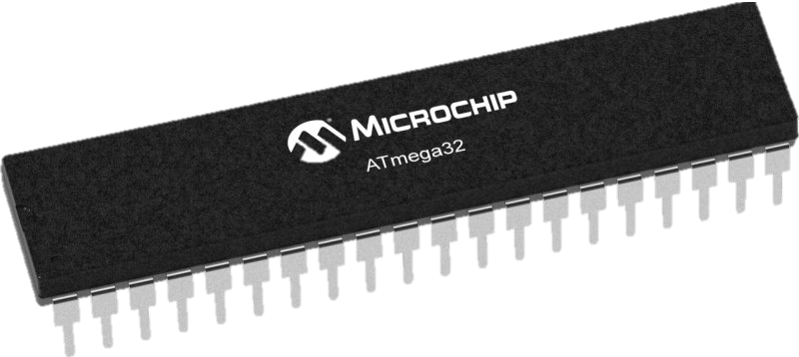
YAPG
Instruments:
ATMega32

Slide 5
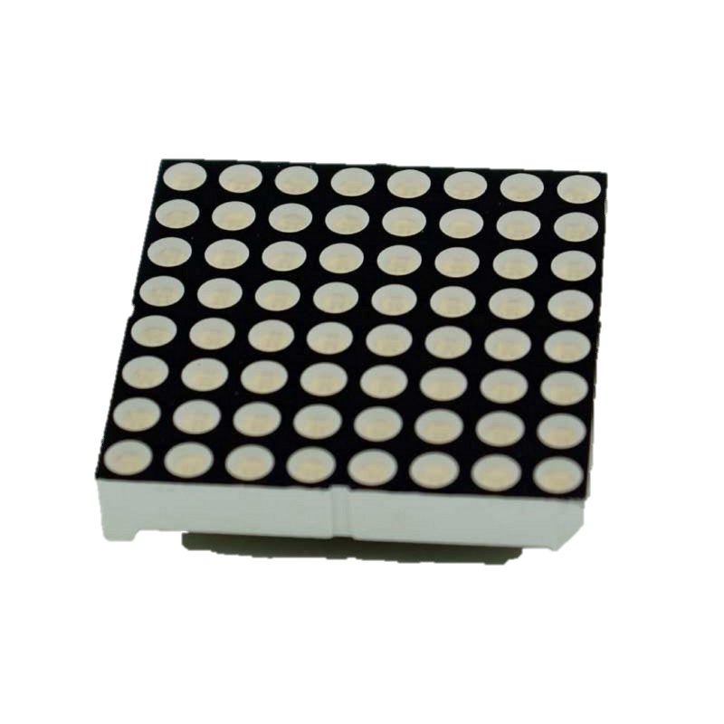
YAPG
Instruments:
ATMega32
Led Matrix (2pc)

Slide 6
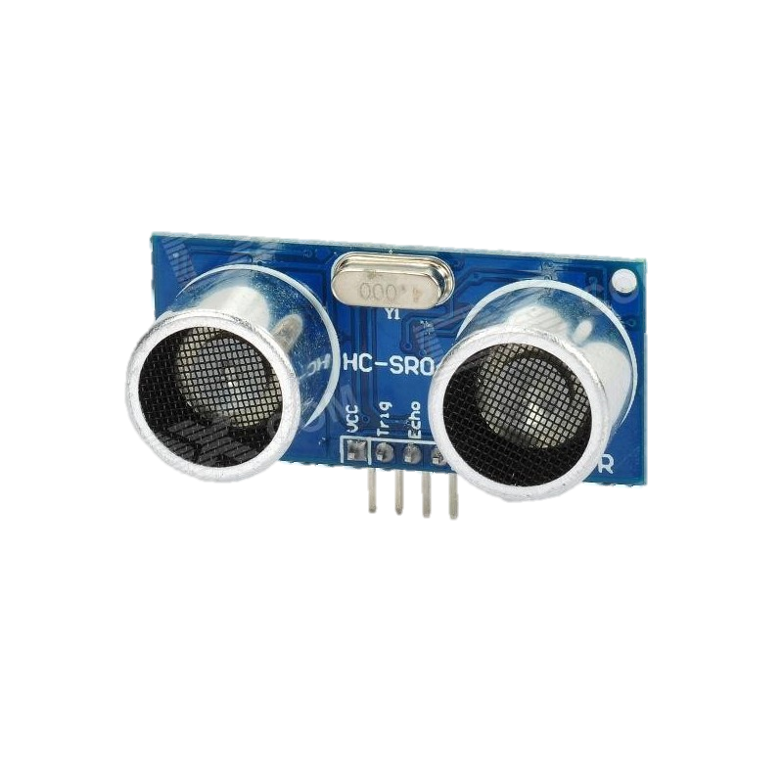
YAPG
Instruments:
ATMega32
Led Matrix (2pc)
Ultrasonic SONAR HC-SR04 (2pc)

Slide 7
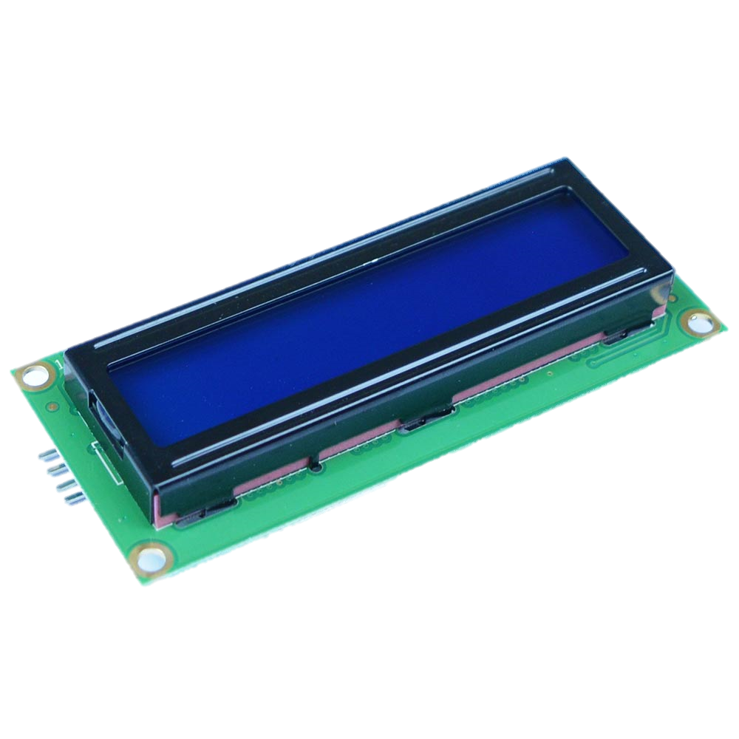
YAPG
Instruments:
ATMega32
Led Matrix (2pc)
Ultrasonic SONAR HC-SR04 (2pc)
LCD Display

Slide 8
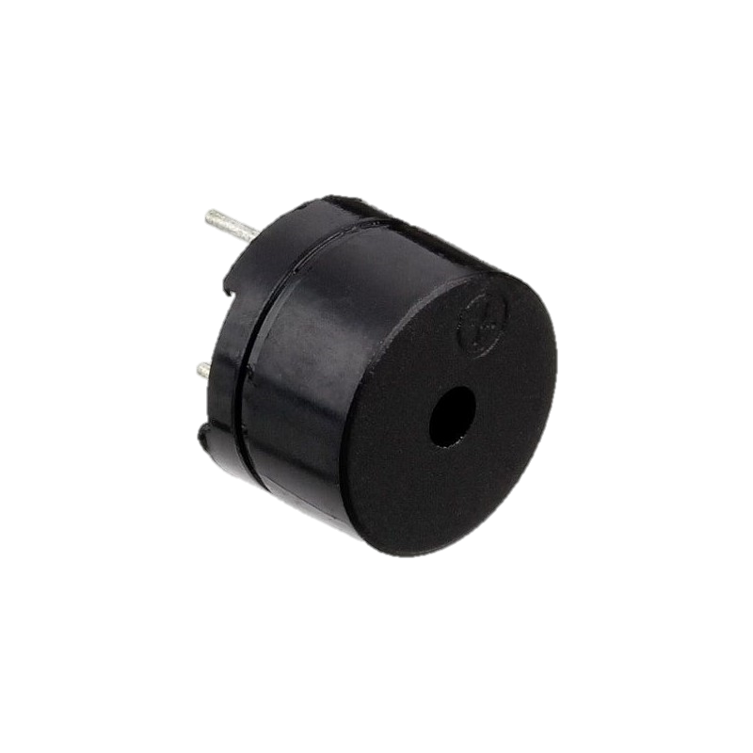
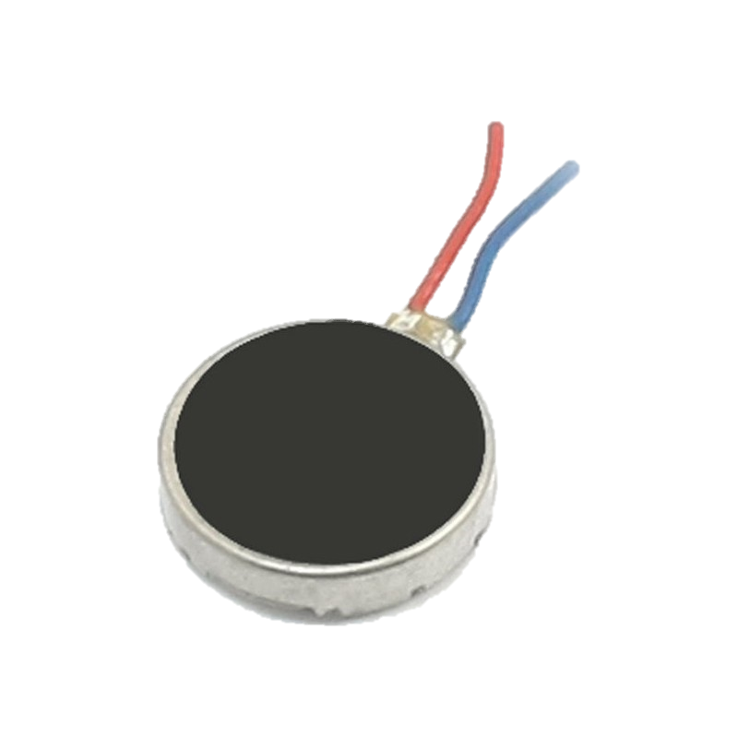
YAPG
Instruments:
ATMega32
Led Matrix (2pc)
Ultrasonic SONAR HC-SR04 (2pc)
LCD Display
Buzzer (2pc)
Vibration Motor (2pc)

Slide 9
Demonstration

Slide 10
